Slide 1
The Question…
A physician is studying mortality among patients with glioblastoma (brain cancer), and they hope to improve clinical guidelines to identify high-risk patients earlier. Using data driven approaches, you are tasked with the following:
Help the physician determine some of the best predictors of longer survival among glioblastoma patients
Develop a model that can provide individualized predictions of survival based on patients’ clinical characteristics, diagnoses, and/or radiomic imaging features

Slide 2
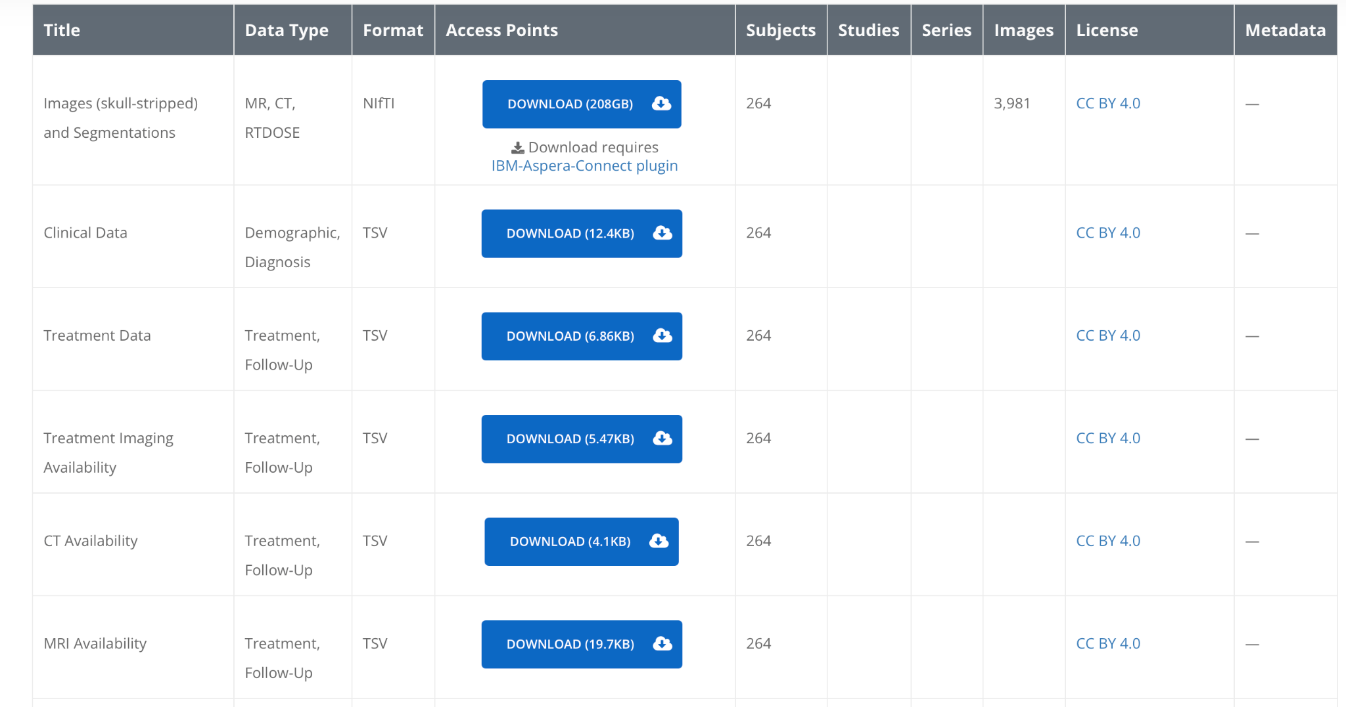
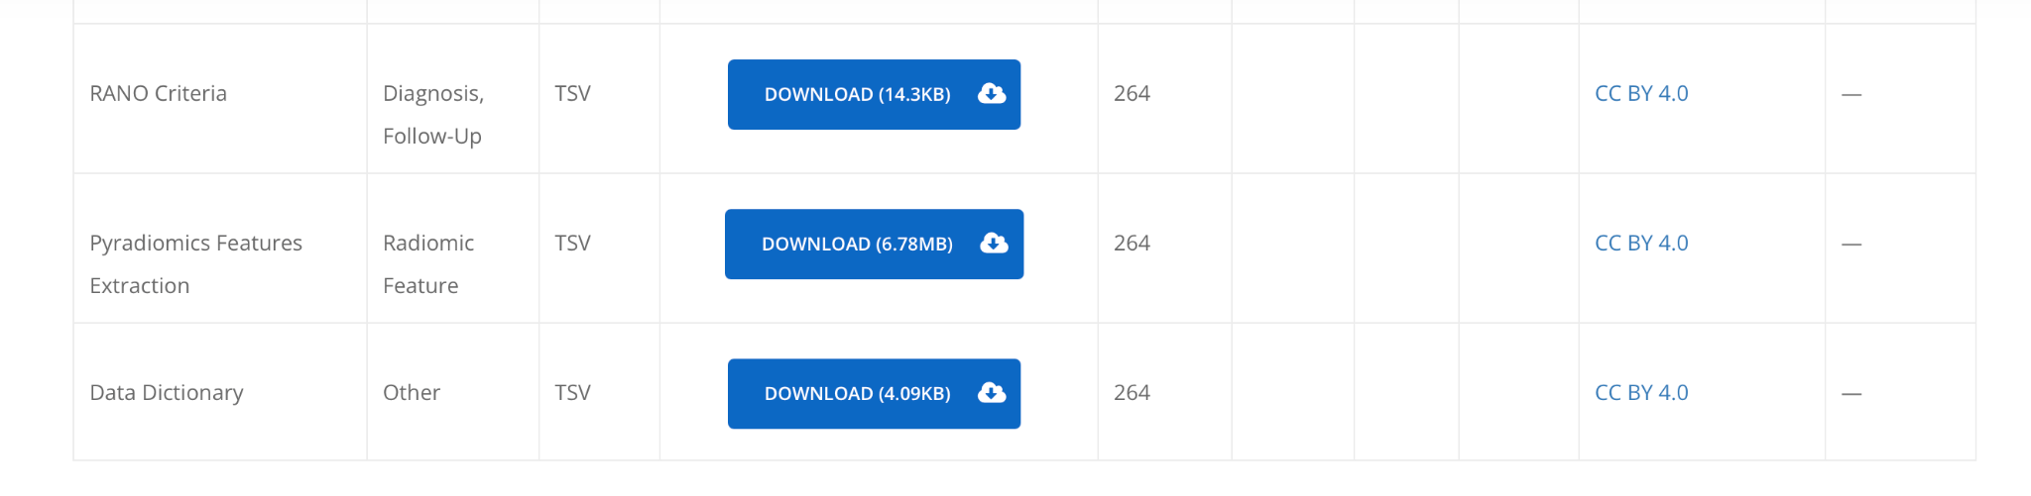
Data
CFB-GBM Dataset from The Cancer Imaging Archive (TCIA)
https://www.cancerimagingarchive.net/collection/cfb-gbm/
Only need Clinical, Treatment, Rano, Pyradiomics, and Data Dictionary!

Slide 3
Data
CFB-GBM Dataset from The Cancer Imaging Archive (TCIA)
https://www.cancerimagingarchive.net/collection/cfb-gbm/
Note: CC-BY 4.0 License
Please do not post the data publicly or upload it to AI tools.

